Slide 1
Intel Products Sentiment Analysis from Online Reviews
- By
Hex Clan
 | Name | College | G-mail
Group Leader | Avinash Patil | YCCE | avinashsp400@gmail.com
Member | Vedika Holani | YCCE | vedikaholani@gmail.com
Member | Shreya Kashyap | YCCE | shreyakashyap557@gmail.com
Member | Rayee Wasankar | YCCE | rayeewasankar2005@gmail.com
Member | Sanika Dashasahastra | YCCE | sanikadashasahastra3504@gmail.com

Slide 2
Overview
Problem Statement
Intel Products are reviewed by end users and tech reviewers on various platforms.
Perform the Sentiment Analysis based on online reviews
Scope : Intel Core Processors (Mobile/Desktop) Out of Scope : GPU, Server, Wireless, FPGA, Ethernet Products
Technical Flow
Data Scraping
Data cleaning
Sentiment Analysis
Results based on analysis

Slide 3
Data Scrapping
Data Source : Amazon Website
Libraries :
Data Scrapping
BeautifulSoup
Requests
Data Manipulation
Pandas
Data Scraped : Reviews on Intel products
Output format : CSV file
CSV file attributes :
Product Title
Review Title
Review Date
Reviews
Rating

Slide 4
Data Scrapping Flow
Import Libraries Extract Data
Define Urls Store extracted data
Define extract Iterate over pages Save to CSV
Review function
Set header Store all data
Send http requests Create dataframe
Parse html content Remove duplicates

Slide 5
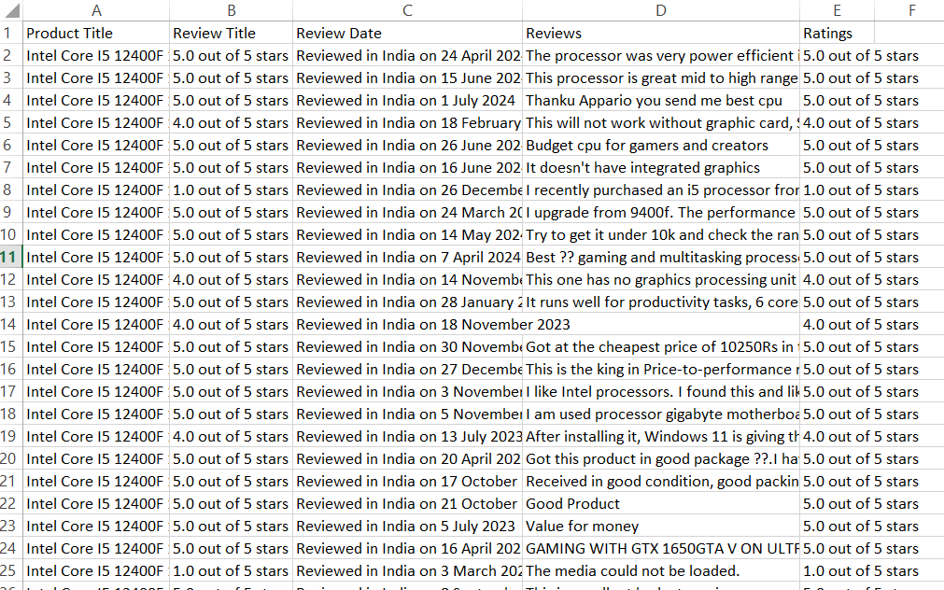

Slide 6
Exploratory Data Analysis
Count - 5001.000000
Mean - 63.923215
Std - 86.997288
Min - 1.000000
25% -12.000000
50% - 35.000000
75% - 87.000000
Max - 1377.000000
Name: review_length
Name: review_length

Slide 7
Data Cleaning and Sentiment Analysis
Download NLTK stopwords, Label encoding Key Features Extraction
punkt tokenizer, VADER lexicon
Rating distribution analysis Extract Keywords
Load dataset
Text cleaning and tokenization Review trends over time Visualization
Function
K-Means Clustering Performance Metrics
Data cleaning
Sentiment Analysis using VADER Recommendations and Summary
Data Summary and
Visualisation WordCloud Visualization Categorization and Saving Results
Train-test split Model Training and Evaluation
TF-IDF vectorization Clustering Analysis

Slide 8
Data Cleaning and Sentiment Analysis
Downloads :
NLTK stopwords
punkt tokenizer
VADER lexicon,etc
Defined a function to clean and tokenize text by removing newlines, punctuation, and converting text to lowercase
Analyze sentiments using the VADER sentiment analyzer
Model Training and Evaluation
Logistic Regression
Random Forest
SVM models
Clustering Analysis
KMeans clustering
Key Features Extraction
Extract key features using Latent Dirichlet Allocation (LDA)
Visualization
SKU distribution
Timeline
technical features

Slide 9
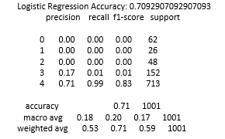
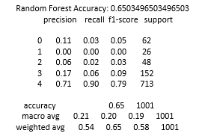
Sentiment Analysis Result

Slide 10
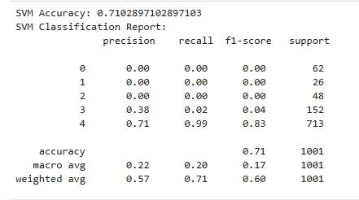

Slide 11
Key Takeaways
Customer Insights :
Our analysis revealed that customers appreciate certain features of the products but also highlighted specific areas needing improvement.
Actionable Recommendations :
By addressing the issues raised in negative reviews, such as cooling and performance stability, companies can improve their products and enhance customer satisfaction.
Model Performance :
The models developed for sentiment analysis can be used to automate the process of review analysis, making it easier for companies to monitor and respond to customer feedback.

